Slide 1

The Art of Data Modeling
Welcome to "The Art of Data Modeling," a journey into the foundational masterpiece that underpins data clarity and trust in the modern enterprise. Data modeling in SQL is more than a technical exercise; it's the strategic blueprint for robust database design, ensuring integrity, consistency, and usability.

Slide 2



Foundational Concepts in Data Modeling
At its core, data modeling defines the structure of information. It involves identifying key components and their interrelationships to create an organized, efficient database.
Entities
Attributes
Relationships
The fundamental objects or concepts about which data is stored, such as "Customer," "Product," or "Order." Each entity represents a distinct, identifiable component within the system.
Specific properties or characteristics that describe an entity, like a customer's "Name," "Email," or a product's "Price." Attributes provide detail and context for each entity.
The crucial connections that show how different entities interact or link to one another, for example, a "Customer" placing multiple "Orders." Relationships define the logical flow of data.

Slide 3
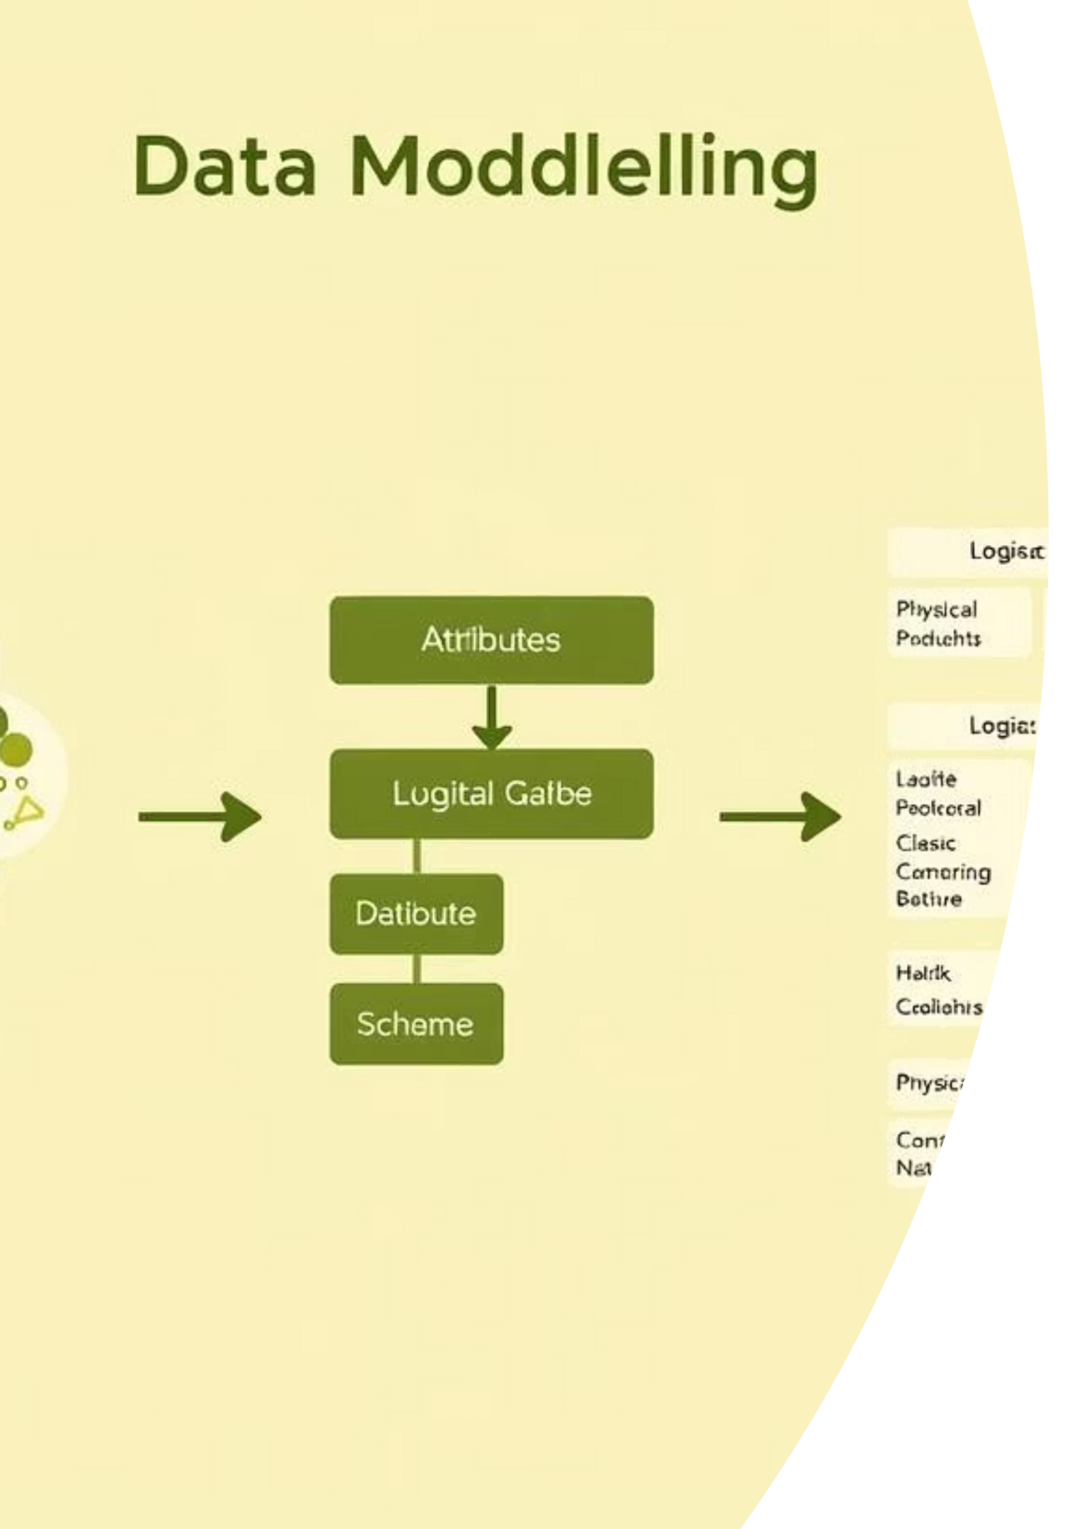
The Three Phases of Data Modeling
Data modeling progresses through distinct phases, each offering a different level of detail and focus, from high-level overviews to specific implementation details.
Conceptual Model
1
A high-level overview emphasizing entities and relationships, without technical specifications. It's a dialogue tool for capturing initial business requirements.
Logical Model
2
A more detailed representation defining data structures, attributes, and keys, independent of a specific database system. Often includes normalization for redundancy.
Physical Model
3
Concerns actual implementation within a chosen database system, specifying table structures, column data types, and indexes with a focus on performance optimization.

Slide 4
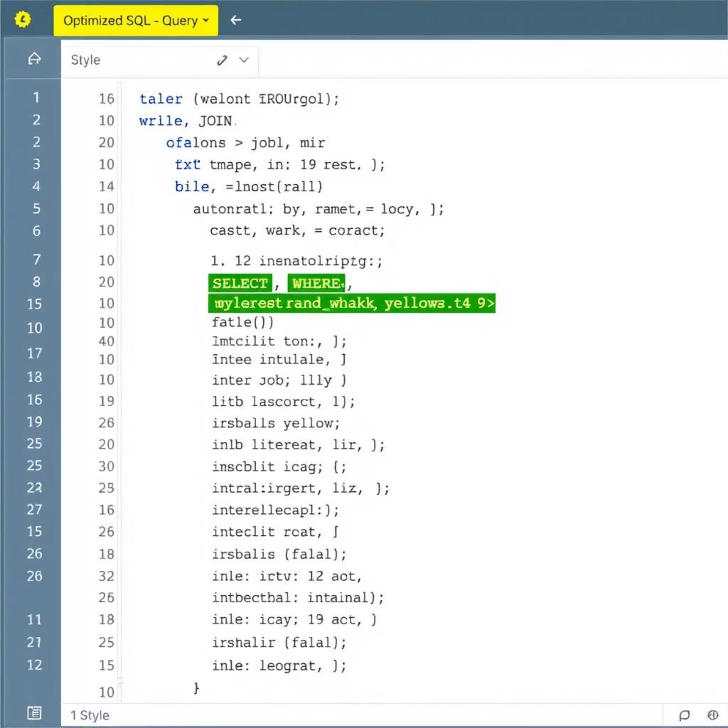
Elevating SQL Data Modeling: Best Practices
While SQL is the universal language for data modeling, effective implementation goes beyond syntax. Optimizing SQL queries is paramount for enhancing performance, readability, and modularity.
Prioritize LEFT JOINs
Favor LEFT JOINs over RIGHT JOINs for improved readability. INNER JOINs are best for ensuring no nulls by including records present in both tables.
Handle Duplicates & Nulls Early
Neglecting these can impede performance. Use functions like COALESCE(), IFNULL(), ISNULL(), DISTINCT, or ROW_NUMBER() to clean data proactively.

Slide 5


Pitfall Avoidance: Advanced SQL Techniques
Avoiding common pitfalls ensures robust and maintainable SQL data models. Leveraging advanced techniques can significantly streamline your code.
Simplify with Window Functions
Standardized Naming Conventions
Use ROW_NUMBER(), RANK(), and FIRST_VALUE() to simplify complex queries. They reduce the need for subqueries and self-joins, making code more readable and efficient.
Employ clear, intuitive naming for models, columns, and aliases (e.g., event_created_at, order_date). Avoid single-letter abbreviations for collaborative clarity.

Slide 6
The dbt Revolution: Software Engineering for Data
dbt (Data Build Tool) transforms data engineering by applying software engineering best practices to SQL within the data warehouse, operating within the ELT paradigm.
90%
85%
95%
Modularity & Reusability
Data Testing & Quality
Automated Documentation
dbt models allow breaking down complex transformations into smaller, reusable SQL queries, referenced by other models using ref().
Built-in support for defining data quality rules, including checks for duplicates, nulls, and accepted values, ensuring data trustworthiness.
The docs command automatically generates an interactive web page visualizing models, relationships, and descriptions from schema.yml.

Slide 7
dbt Project Architecture: A Four-Layer Structure
A common dbt architectural pattern involves a layered approach, ensuring data quality, transformation, and readiness for analytics.
Intermediate Layer (int_)
Mart Layer (fct_, dim_)
Optional but valuable for reusable joins, window functions, or aggregations supporting complex business logic across multiple marts.
Curated, business-ready layer for reporting and analytics. High accuracy and clear naming are crucial here.
Source Layer (sources.yml)
Staging Layer (stg_)
Declares raw data tables or views from the data warehouse, always routed through the staging layer.
The "cleaning zone" for raw data: columns renamed, types fixed, initial filters applied, maintaining source data shape.

Slide 8

The Imperative of Database Version Control
Database version control, or versioning, is crucial for ensuring database integrity during deployments, preventing loss, breakage, or unintentional modifications.
1
State-based Approach
Declares desired ideal database state; tooling generates SQL scripts by comparing against a target. Can complicate consistent releases.
2
Migration-based Approach
Tracks specific, incremental changes applied to each database. Aligns with "build once, deploy often" DevOps philosophy.
3
Hybrid Approach (e.g., Liquibase)
Combines migration-based primary approach with schema comparisons to detect "drift" or unauthorized changes.

Slide 9








Data Modeling: Future Trends
Data modeling continues to evolve, adapting to new technologies and increasing demands for clarity, security, and trust in complex data landscapes.
AI's Growing Impact
Flexibility & Scalability
AI assists modelers by suggesting optimizations and ensuring privacy alignment.
Adoption of graph databases and knowledge graphs for complex, real-time data.
Enhanced Data Quality & Trust
Interconnected Governance
Data models supporting regulations, lineage, and metadata management.
Focus on data literacy, security, and integrity to maintain trust.

